Slide 1
Vitals Upgrade – Georgia State Hackathon
3/25/18

Slide 2
Differences*
*sales pitch
App → Web Browser Plugin
one install for constant use
not something to “take out” but something that is already there
Incentive → Convenience
incentivizing the app could be costly and ineffective
additional plugin functionality encourages frequent and consistent use
Event → Daily Life
to avoid loss of interest, it should not be an interesting thing at all
plugin is seen as an almost default feature of browser
novelty loss is avoided similar to interest with this being seen as a tool and not an accessory
2
NOT NECESSARILY COMPANY CONFIDENTIAL | FOR USE ONLY | MAYBE COPY

Slide 3
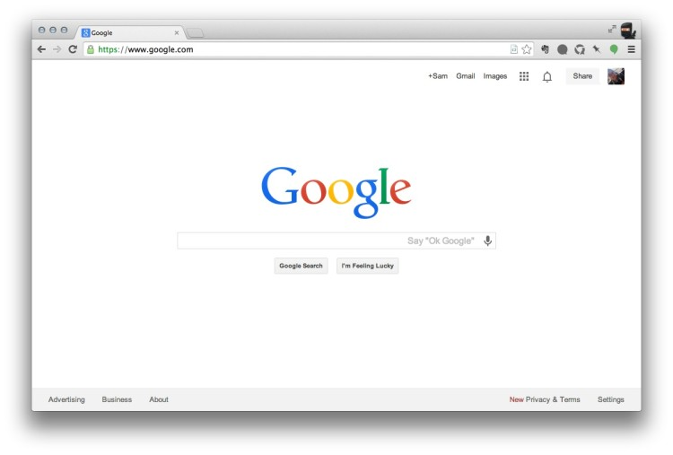
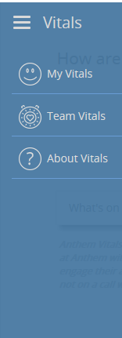

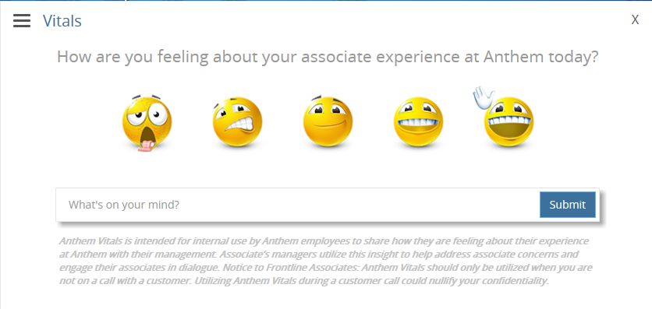


Vitals Plugin – User Interface Relocation
3
NOT NECESSARILY COMPANY CONFIDENTIAL | FOR USE ONLY | MAYBE COPY

